Slide 1
VR: 101 Design and Development
Katherine ‘Kat’ Harris
Microsoft
@KatVHarris
Notes:
Hi MY name is Kat harris I’m a technical evangelist at Microsoft and today I’ll be talking about the basic design principles of VR and the differences between that and game development. As well as show you how to get started with Unity.

Slide 2
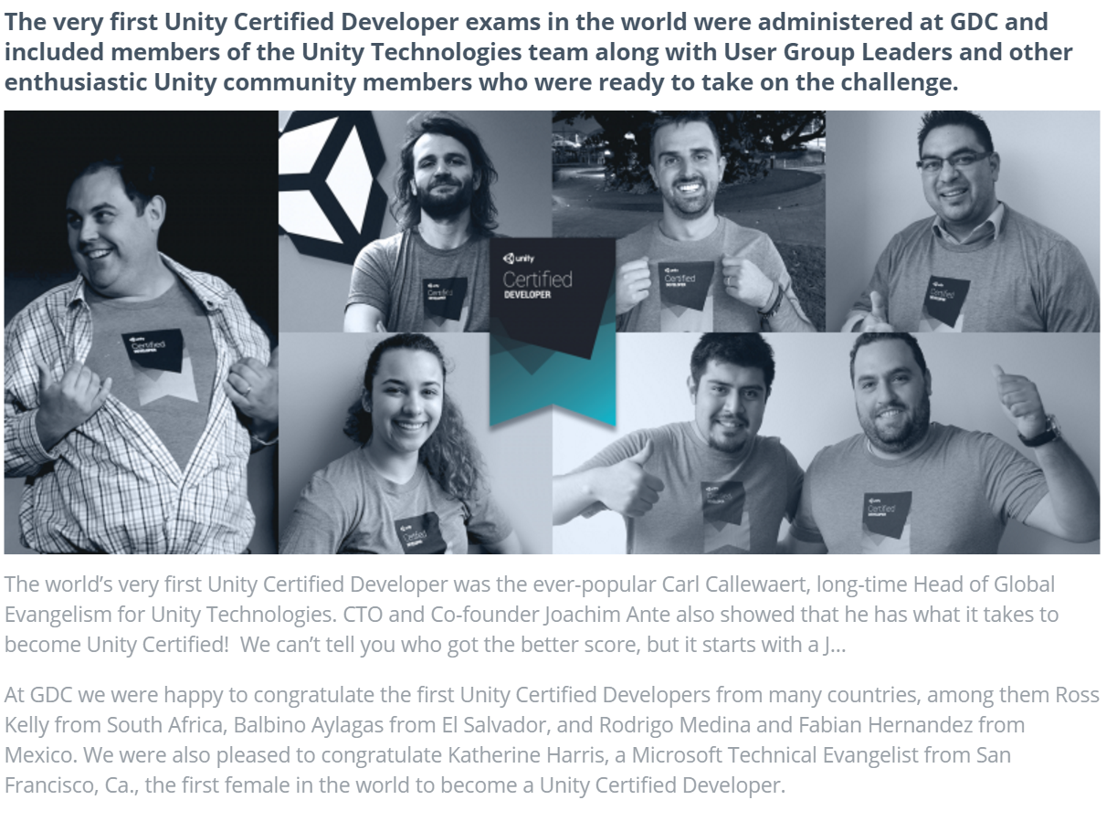
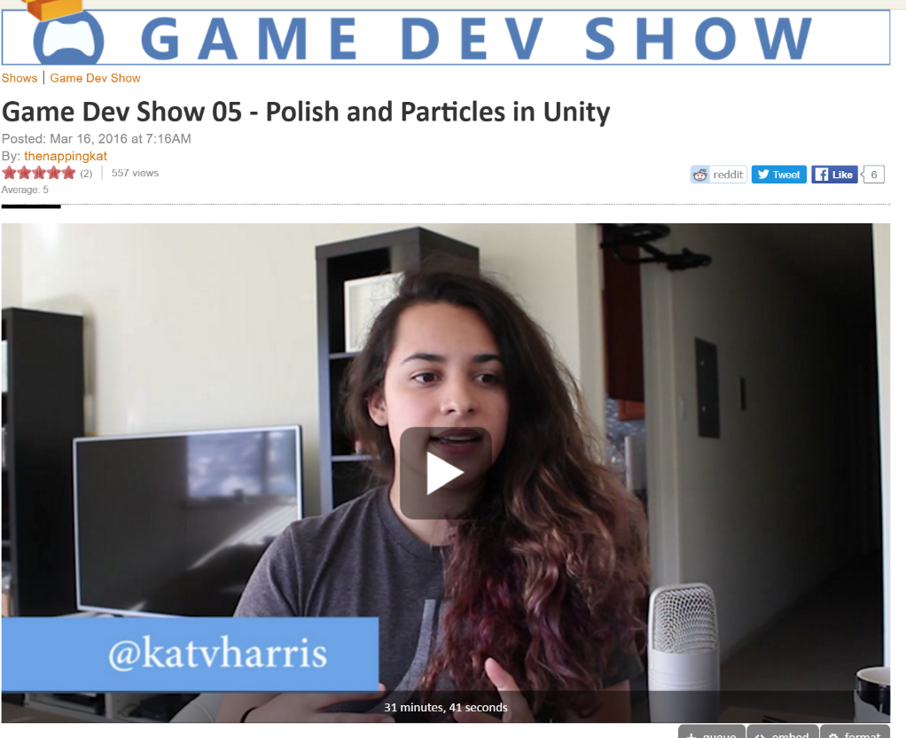

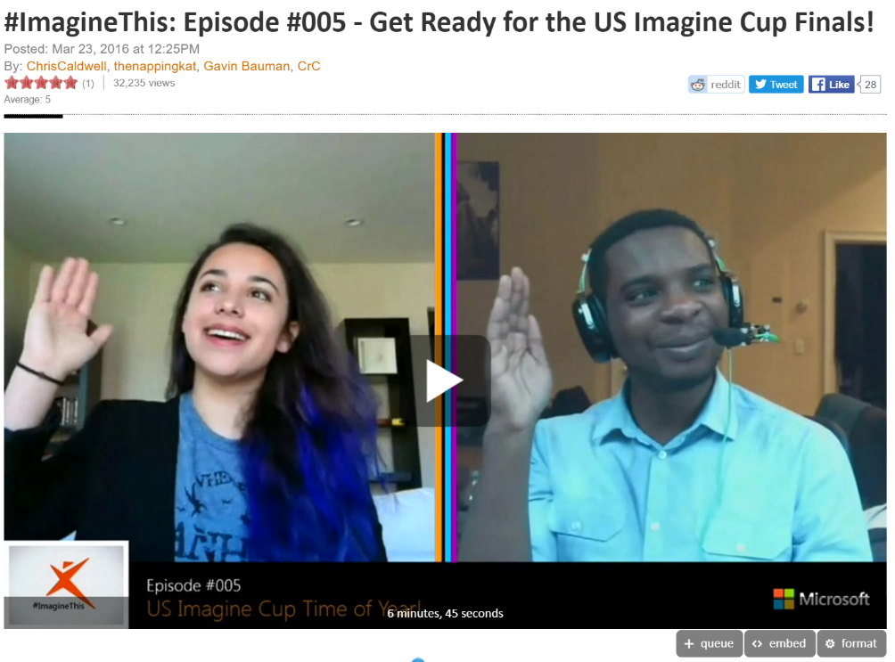
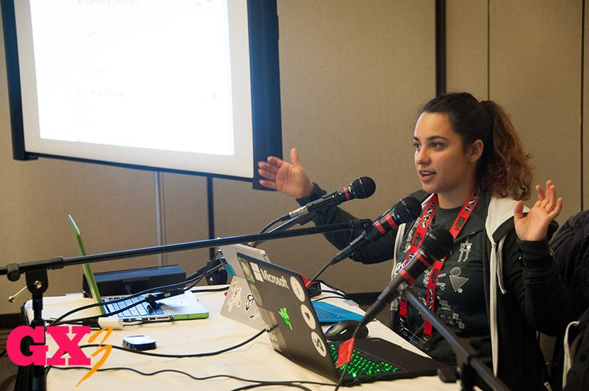

2015
Notes:
A little about me. I’m a technical Evangelist at Microsoft. A Technical Evangelist is a developer that teaches how to use the Microsoft platform or helps to build tools for other developers to make their lives easier when working with our products.
We do this by making really cool demos and then talking about it. I have hosted some of the Micrfsofots ame dev show. As well as spoke at Grace Hopper and other conferences. I was also the first woman in the world to get my unity certification.
Now from a technical standpoint there isn’t much difference. You can use Unity. However from a design standpoint there are many THINGS, that you need to take in consideration.
[SHOW DEMO OF GAME]
How many of you have used Unity to build a game.
Okay Here is my game. It’s a really quick one I made that just shoots boulders on mars.

Slide 3
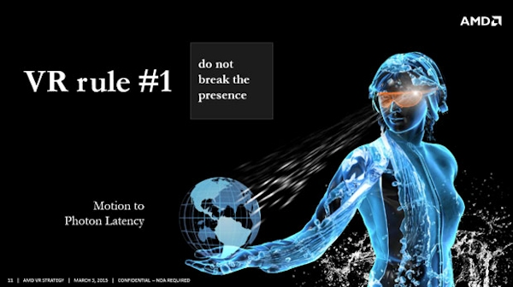
Presence
Hardware
Movement
User Controls
Environment
Notes:
Well the first rule of VR is Never break Presence. What is presence, well in VR we define it as type of immersion.
Presence can be measured as the degree to which the virtual environment faithfully evokes a sense of reality that causes the user to suspend disbelief. The greater the suspension of disbelief, the greater the degree of presence achieved.
Researchers exploring virtual reality divide VR presence into three main subcategories: personal, social and environmental.
Personal presence refers to the user perceiving that they physically exist within a virtual world.
Social presence involves interactivity with other simulated or real entities within the virtual world.
And environmental presence occurs when the virtual world seems aware of the VR user and reacts accordingly.
There have been white papers about presence and how to define it and achieve it since the 90s.

Slide 4
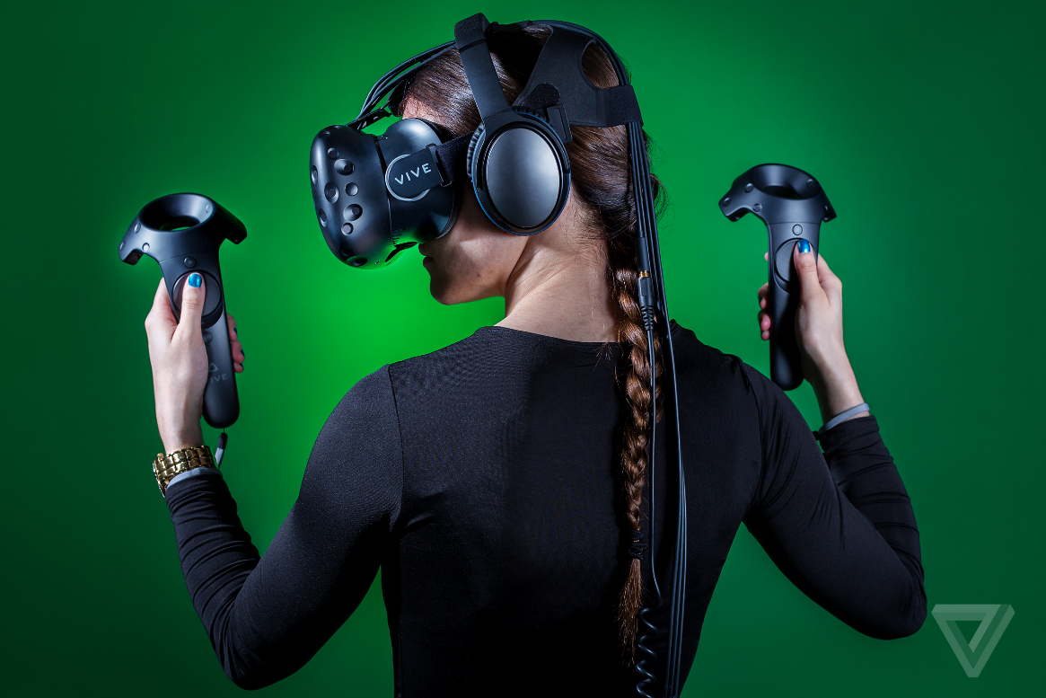
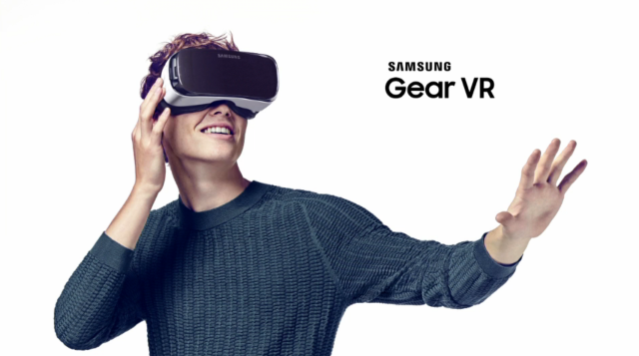
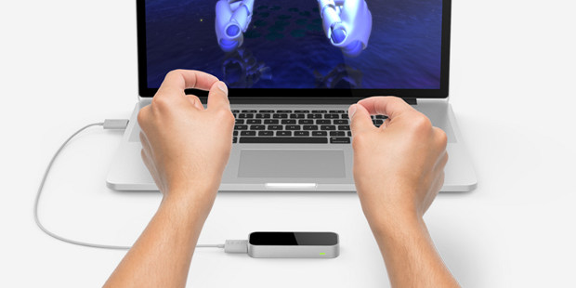
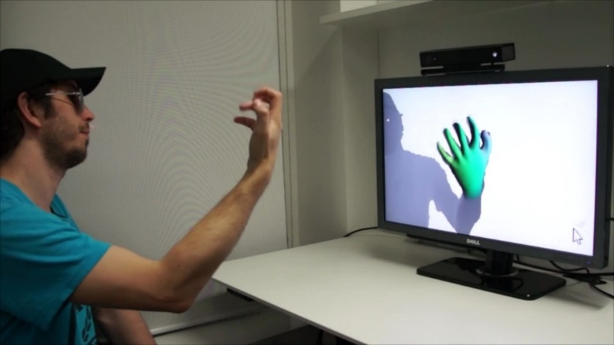
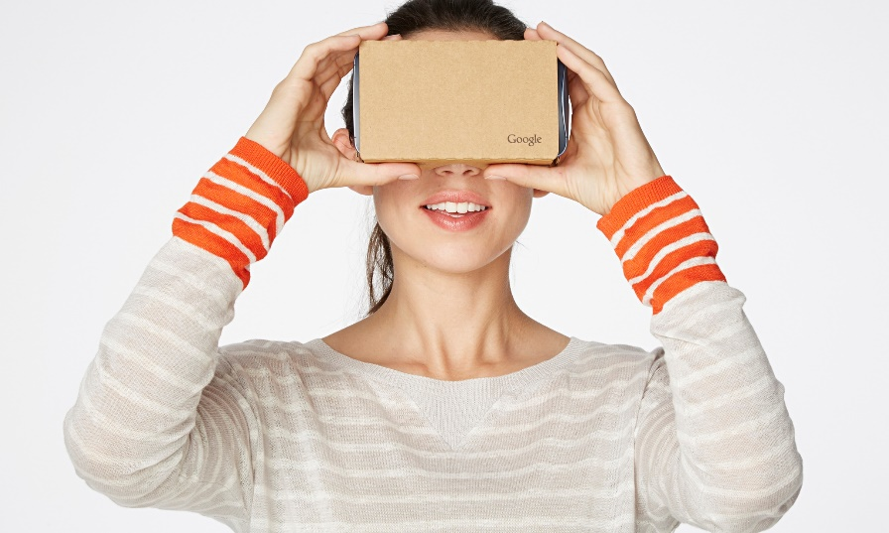
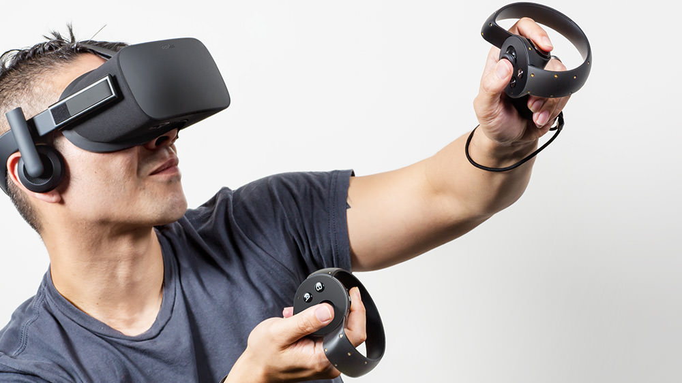
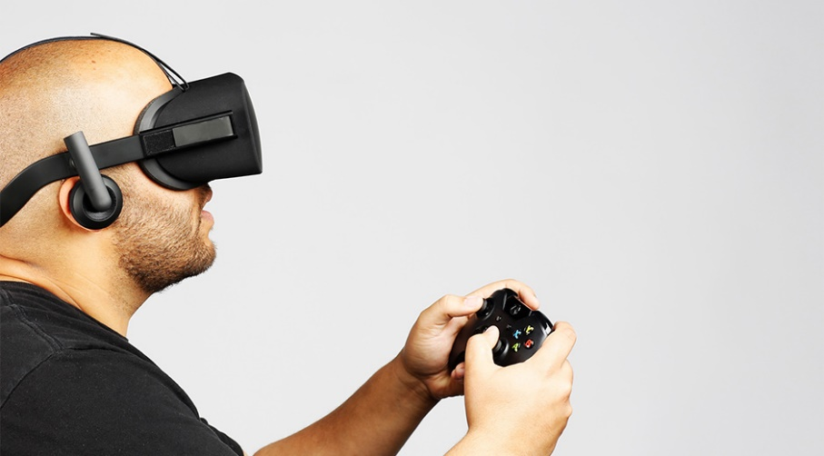
Choosing Hardware
Notes:
Choosing Hardware is extremely important in creating your VR Experience.
Because there are so many headsets it’s important to know which one your developing for and Designing around the limitations of each.
Deciding which hardware you want determines the functionality and features of your entire experience.
If you don’t have controller input, or a headset with controller input, you can’t create an experience with those inputs.

Slide 5
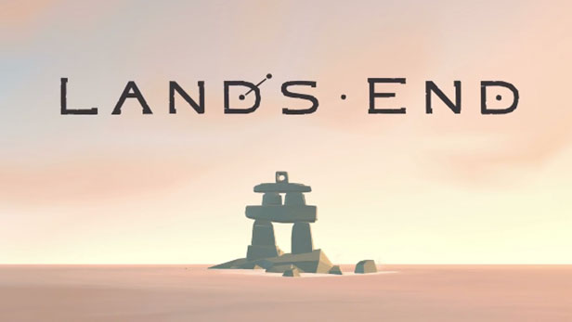
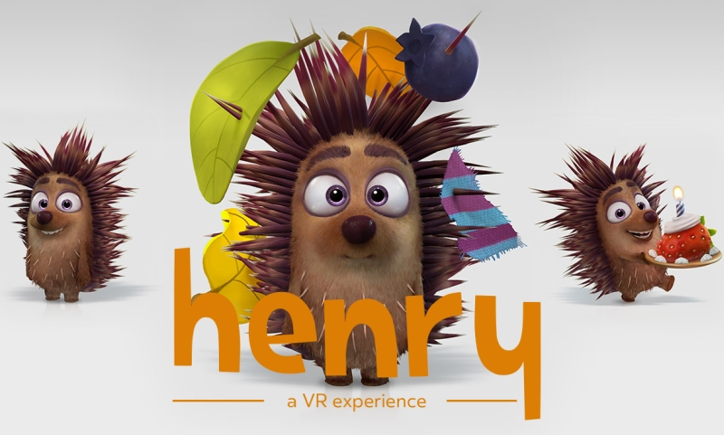

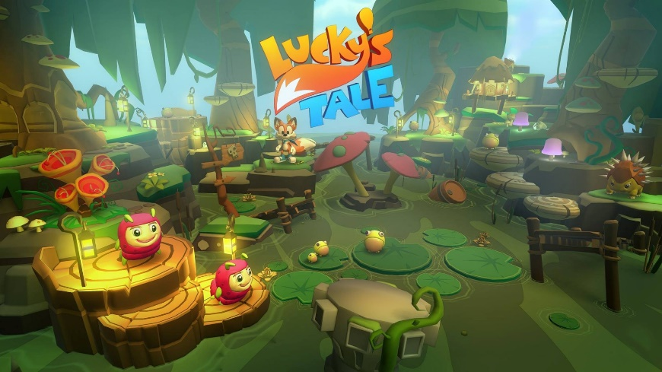
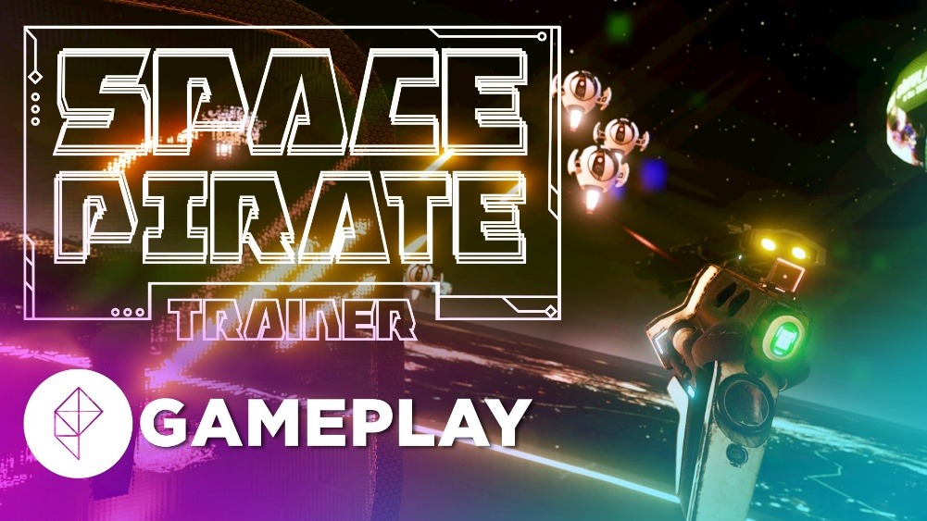
Player Movement
Stationary
3d Person
Teleportation
Constant speed
Slow movement
Room Scale
Notes:
How is the player going to move around your experience? Bad movement is one of the easiest ways to break presence.
Are you creating a passive experience? Is the User stationary and just watching your experience?
Do you want the User to remain stationary but is controlling an avatar?
Can move around with teleportation?
Do they have constant movement?
Or is it roomscale?
Now that you’ve decided which pieces of hardware you are using this makes it a bit easier to decide… kind of.

Slide 6
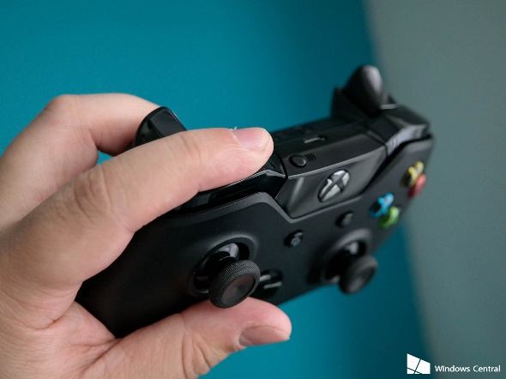
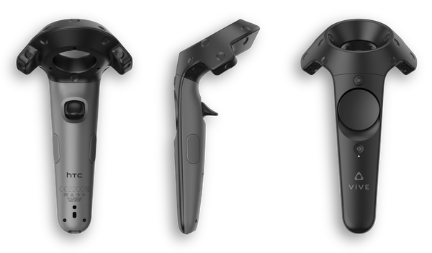
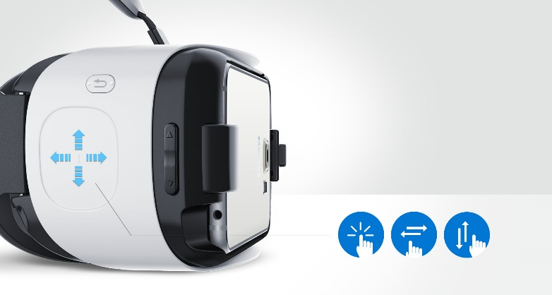

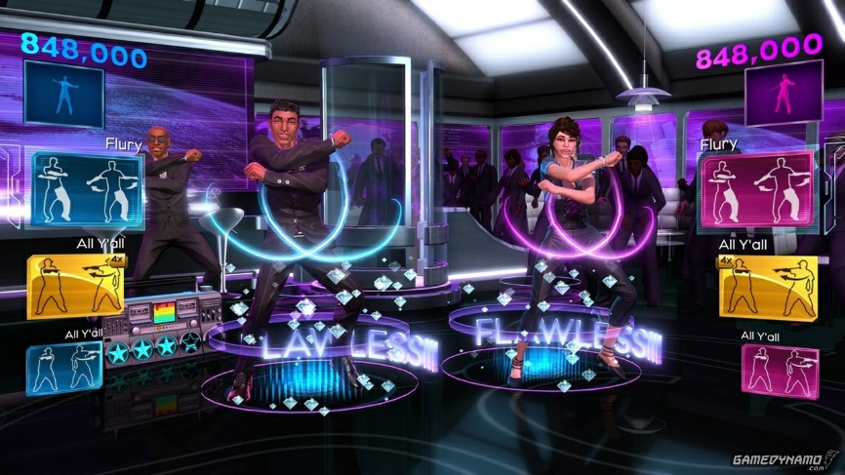
User Input /Controls
Simple
Select - tap
Select + Hold – tap + hold
Move - swipe
Intuitive
Select is always select
Trigger is a Trigger
Notes:
Presence consists not only of what we put into a virtual experience, but also of what the user expects to happen.
Keeping the input simple and intuitive will keep presence longer. Which is the whole goal of VR.

Slide 7
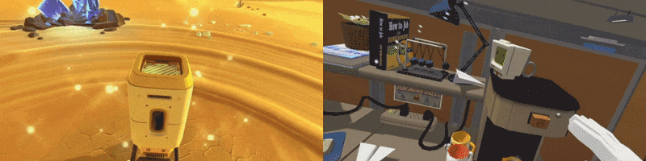
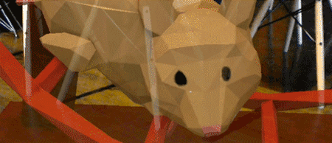
Environment
Weight
Collisions
Cosmic Trip – FunkTronic Job Simulator – Owlchemy labs
HoloLens Holograms app
Notes:
How the environment interacts with the user is also important for Presence. The user is expecting the environment to behave a certain way.
VR is not Traditional Game or Simulation
STOP TRYING TO MAKE IT THE SAME THEY ARE NOT!
You can’t really control where a player looks, or where they walk(with room scale)
If an object is in arms reach of a player you can bet that they will try and stick there hand through it or head.
So the object representing the player’s hand shouldn’t just stop at the wall if their hand keeps going; that’s an easy way to break presence.
Let the player stick their head through the walls or objects.

Slide 8


Engines and SDKs
HoloLens
Daydream
Oculus
Gear
Daydream
Steam VR

Slide 9
Demo
Turning a game into a GearVR Application
Oculus Unity Utility
Build Guide:
Android SDK, Java JDK, Oculus Mobile SDK – Make sure everything is updated
Android ADB and Oculus Sig
Assets/Plugins/Android/assets/
Render Path – Forward // Multithreaded Rendering – Yes

Slide 10
Extra Help
http://uploadvr.com/
http://elevr.com/collision-in-vr/
https://medium.com
Podcasts – Voices of VR and The Real Virtual Show
Facebook Groups
Meetup.com
Twitter

Slide 11


Questions? Katherine (Kat) Harris
Twitter: @KatVHarris
kaharri@Microsoft.com
https://github.com/KatVHarris/
Notes:
ME
GitHub
Unite
AUDIENCE
Now before we get to that I wanted to talk to you I wanted to tell you a little about myself and why I wanted to talk to you about this topic. As I mentioned before I’m an evangelist at Microsoft. Does anyone know what that is? It means that I get to play with cool technology and gamify almost anything I can get my hands on. As well as teaching others how to do the same. So everything I talk about will be released on my blog next week. And the base project for what I do is on github. I use that project as a simple Unity game.
I recently made a Kinect and Oculus integrated infinite runner. And after I completed it I wanted to release it into the store. But before I could I went to Unite Unity’s Dev conference in Boston. I learned about there new analytics and ads systems. And how the pay off of using these sytems was so large with virtual no overhead. So that’s what I’m going to show you today.

